Slide 1
Chapter 8
The Trigonometric Functions

Slide 2

Chapter Outline
Radian Measure of Angles
The Sine and the Cosine
Differentiation and Integration of sin t and cos t
The Tangent and Other Trigonometric Functions

Slide 3
§ 8.1
Radian Measure of Angles

Slide 4
Section Outline
Radians and Degrees
Positive and Negative Angles
Converting Degrees to Radians
Determining an Angle

Slide 5
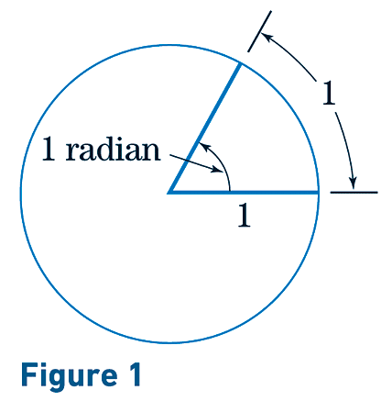

Radians and Degrees
The central angle determined by an arc of length 1 along the circumference of a circle is said to have a measure of 1 radian.
To convert degrees to radians, multiply the number of degrees by π/180.

Slide 6
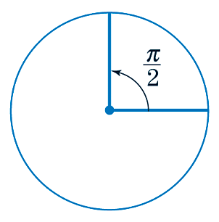

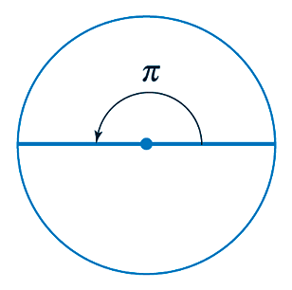
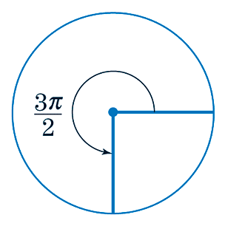
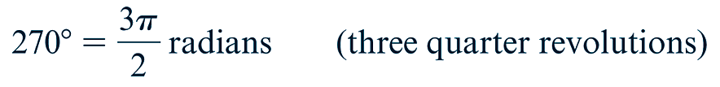
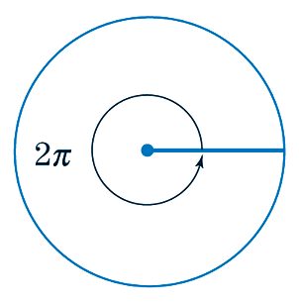
Radians and Degrees

Slide 7
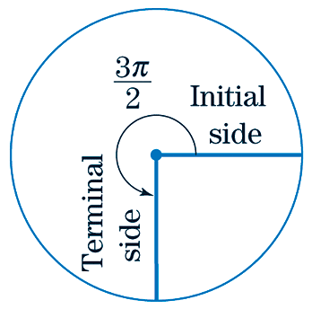
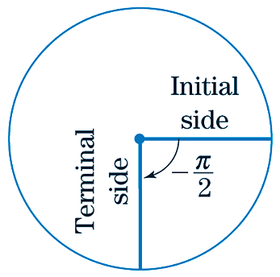
Positive & Negative Angles
Definition | Example
Positive Angle: An angle measured in the counter-clockwise direction
Definition | Example
Negative Angle: An angle measured in the clockwise direction

Slide 8
Converting Degrees to Radians
EXAMPLE
Convert the following to radian measure
SOLUTION

Slide 9
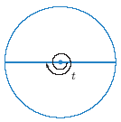
Determining an Angle
EXAMPLE
Give the radian measure of the angle described.
SOLUTION
The angle above consists of one full revolution (2π radians) plus one half-revolutions (π radians). Also, the angle is clockwise and therefore negative. That is,

Slide 10
§ 8.2
The Sine and the Cosine

Slide 11
Section Outline
Sine and Cosine
Sine and Cosine in a Right Triangle
Sine and Cosine in a Unit Circle
Properties of Sine and Cosine
Calculating Sine and Cosine
Using Sine and Cosine
Determining an Angle t
The Graphs of Sine and Cosine

Slide 12

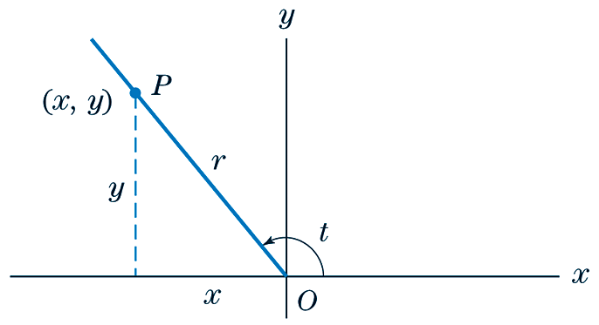
Sine & Cosine

Slide 13

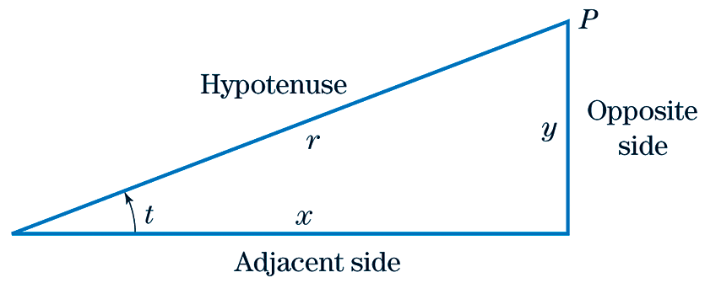
Sine & Cosine in a Right Triangle

Slide 14
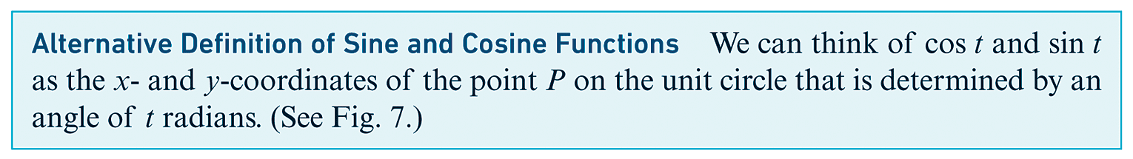
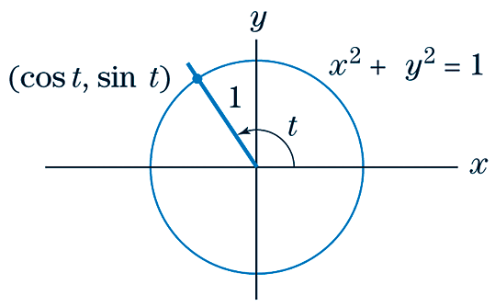
Sine & Cosine in a Unit Circle

Slide 15

Properties of Sine & Cosine

Slide 16
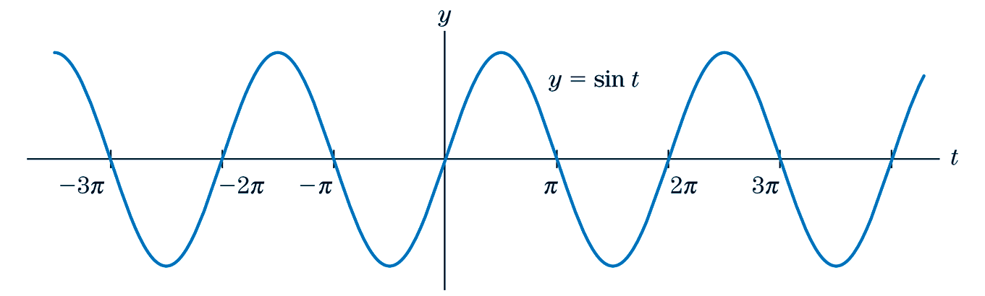
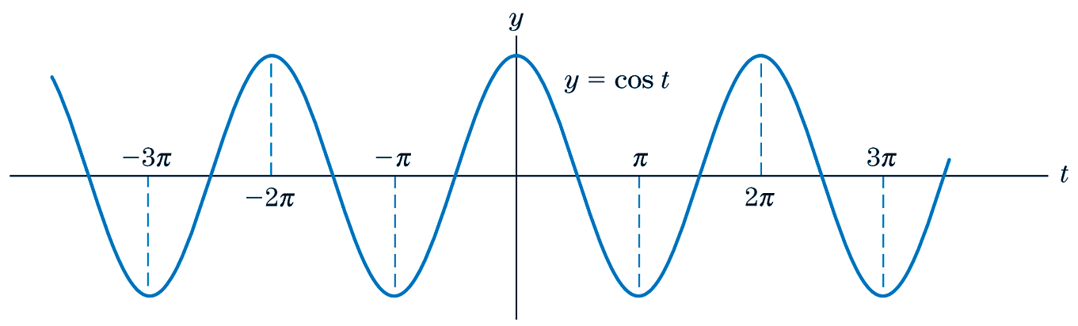
The Graphs of Sine & Cosine

Slide 17

Calculating Sine & Cosine
EXAMPLE
Give the values of sin t and cos t, where t is the radian measure of the angle shown.
SOLUTION
Since we wish to know the sine and cosine of the angle that measures t radians, and because we know the length of the side opposite the angle as well as the hypotenuse, we can immediately determine sin t.
Since sin²t + cos²t = 1, we have

Slide 18
Calculating Sine & Cosine
CONTINUED
Replace sin²t with (1/4)².
Simplify.
Subtract.
Take the square root of both sides.

Slide 19
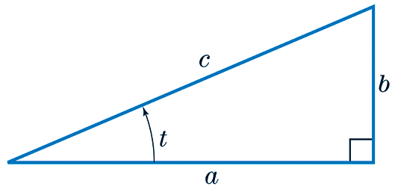
Using Sine & Cosine
EXAMPLE
If t = 0.4 and a = 10, find c.
SOLUTION
Since cos(0.4) = 10/c, we get

Slide 20
Determining an Angle t
EXAMPLE
Find t such that –π/2 ≤ t ≤ π/2 and t satisfies the stated condition.
SOLUTION
One of our properties of sine is sin(-t) = -sin(t). And since -sin(3π/8) = sin(-3π/8) and –π/2 ≤ -3π/8 ≤ π/2, we have t = -3π/8.

Slide 21
§ 8.3
Differentiation and Integration of sin t and cos t

Slide 22
Section Outline
Derivatives of Sine and Cosine
Differentiating Sine and Cosine
Differentiating Cosine in Application
Application of Differentiating and Integrating Sine

Slide 23


Derivatives of Sine & Cosine
Combining (1), (2), and the chain rule, we obtain the following general rules:

Slide 24
Differentiating Sine & Cosine
EXAMPLE
Differentiate the following.
SOLUTION

Slide 25
Differentiating Cosine in Application
EXAMPLE
Suppose that a person’s blood pressure P at time t (in seconds) is given by P = 100 + 20cos 6t.
Find the maximum value of P (called the systolic pressure) and the minimum value of P (called the diastolic pressure) and give one or two values of t where these maximum and minimum values of P occur.
SOLUTION
The maximum value of P and the minimum value of P will occur where the function has relative minima and maxima. These relative extrema occur where the value of the first derivative is zero.
This is the given function.
Differentiate.
Set P΄ equal to 0.
Divide by -120.

Slide 26
Differentiating Cosine in Application
CONTINUED
Notice that sin6t = 0 when 6t = 0, π, 2π, 3π,... That is, when t = 0, π/6, π/3, π/2,... Now we can evaluate the original function at these values for t.
t | 100 + 20cos6t
0 | 120
π/6 | 80
π/3 | 120
π/2 | 80
Notice that the values of the function P cycle between 120 and 80. Therefore, the maximum value of the function is 120 and the minimum value is 80.

Slide 27
Application of Differentiating & Integrating Sine
EXAMPLE
(Average Temperature) The average weekly temperature in Washington, D.C. t weeks after the beginning of the year is
The graph of this function is sketched on the following slide.
(a) What is the average weekly temperature at week 18?
(b) At week 20, how fast is the temperature changing?

Slide 28
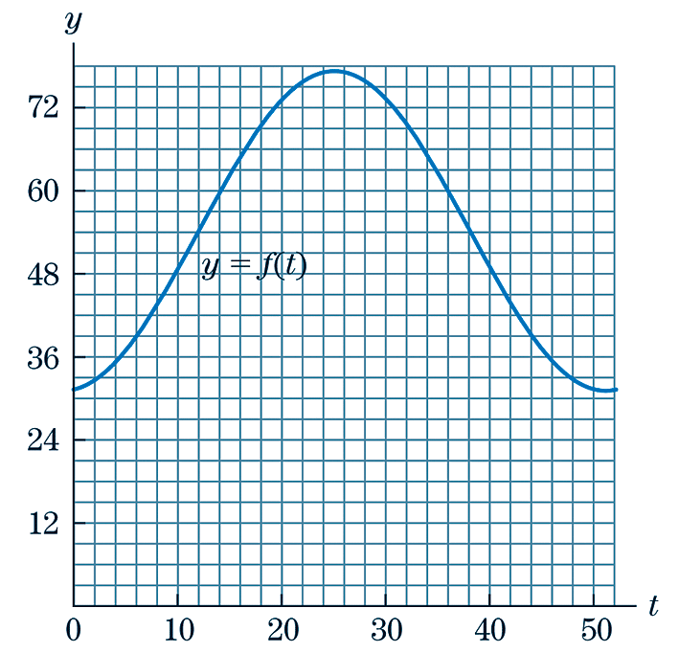
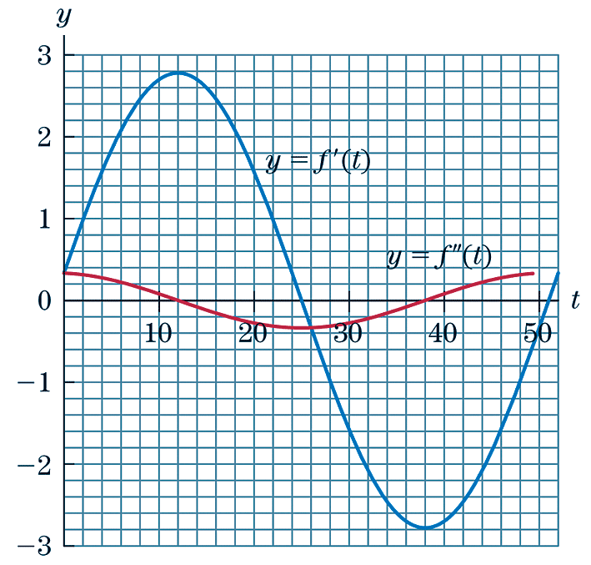
Application of Differentiating & Integrating Sine
CONTINUED

Slide 29
Application of Differentiating & Integrating Sine
CONTINUED
SOLUTION
(a) The time interval up to week 18 corresponds to t = 0 to t = 18. The average value of f (t) over this interval is

Slide 30
Application of Differentiating & Integrating Sine
CONTINUED
Therefore, the average value of f (t) is about 47.359 degrees.
(b) To determine how fast the temperature is changing at week 20, we need to evaluate f ΄(20).
This is the given function.
Differentiate.
Simplify.
Evaluate f ΄(20).
Therefore, the temperature is changing at a rate of 1.579 degrees per week.

Slide 31
§ 8.4
The Tangent and Other Trigonometric Functions

Slide 32
Section Outline
Other Trigonometric Functions
Other Trigonometric Identities
Applications of Tangent
Derivative Rules for Tangent
Differentiating Tangent
The Graph of Tangent

Slide 33
Other Trigonometric Functions
Certain functions involving the sine and cosine functions occur so frequently in applications that they have been given special names. The tangent (tan), cotangent (cot), secant (sec), and cosecant (csc) are such functions and are defined as follows:

Slide 34


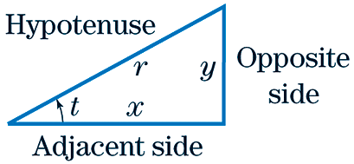
Other Trigonometric Identities

Slide 35
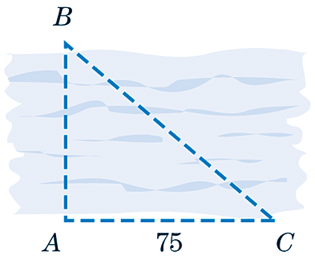
Applications of Tangent
EXAMPLE
Find the width of a river at points A and B if the angle BAC is 90°, the angle ACB is 40°, and the distance from A to C is 75 feet.
r
SOLUTION
Let r denote the width of the river. Then equation (3) implies that

Slide 36
Applications of Tangent
CONTINUED
We convert 40° into radians. We find that 40° = (π/180)40 radians ≈ 0.7 radians, and tan(0.7) ≈ 0.84229. Hence

Slide 37
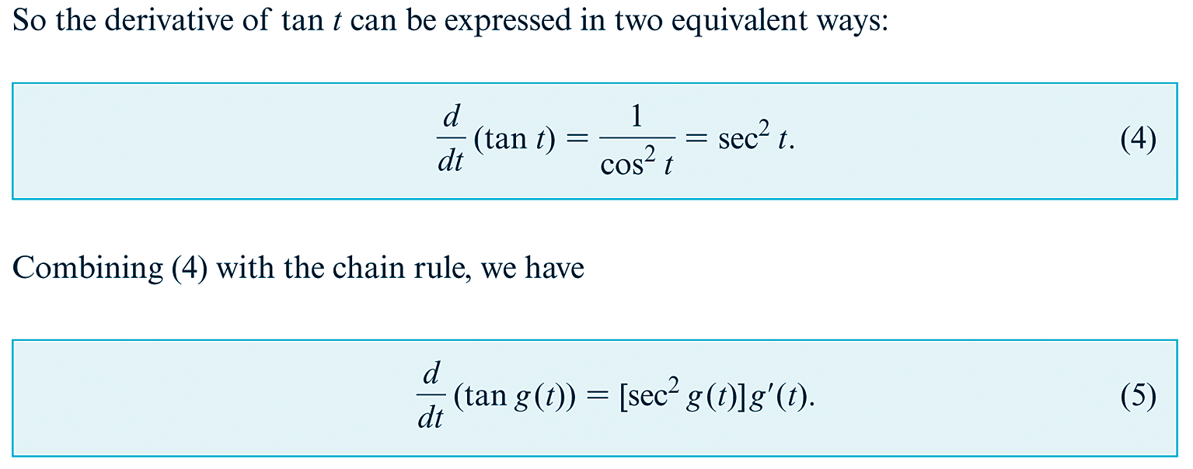
Derivative Rules for Tangent

Slide 38
Differentiating Tangent
EXAMPLE
Differentiate.
SOLUTION
From equation (5) we find that

Slide 39
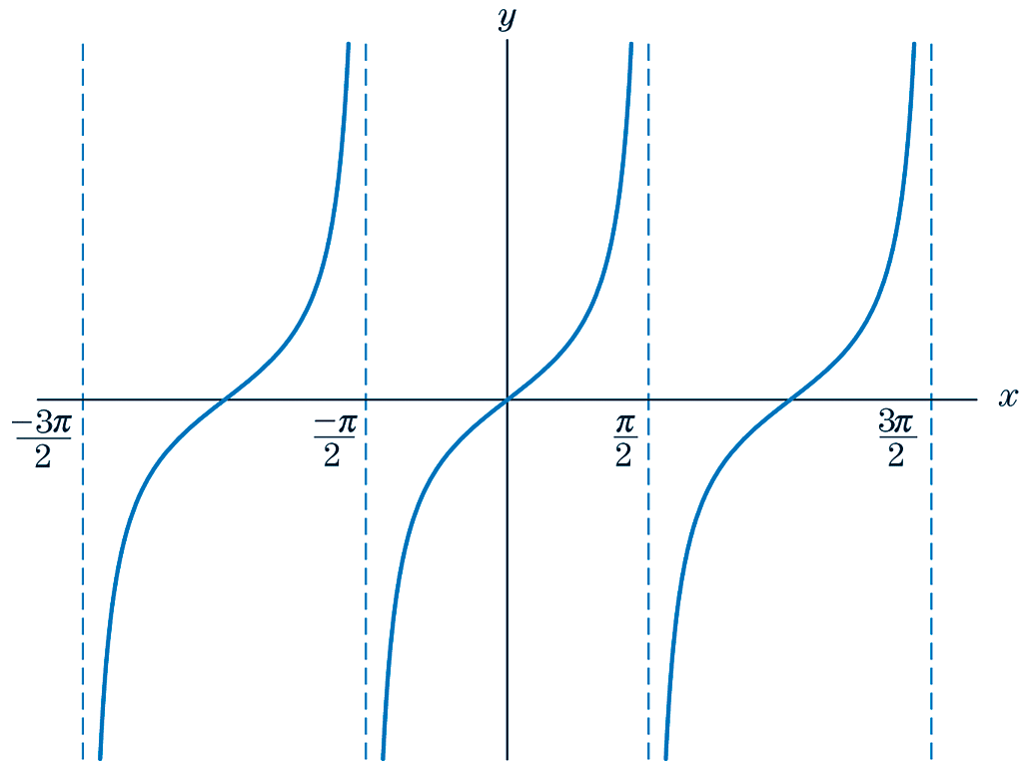
The Graph of Tangent
tan t is defined for all t except where cos t = 0. (We cannot have zero in the denominator of sin t/ cos t.) The graph of tan t is sketched in Fig. 5. Note that tan t is periodic with period π.
Fig. 5 Graph of Tangent Function

