Slide 1
Chapter 10 Differential Equations

Slide 2

Chapter Outline
Solutions of Differential Equations
Separation of Variables
First-Order Linear Differential Equations
Applications of First-Order Linear Differential Equations
Graphing Solutions of Differential Equations
Applications of Differential Equations
Numerical Solution of Differential Equations

Slide 3
§ 10.1
Solutions of Differential Equations

Slide 4
Section Outline
Definition of Differential Equation
Using Differential Equations
Orders of Differential Equations
Solution Curves
Constant Solutions of Differential Equations
Applications of Differential Equations
Slope Fields
Applications Using Slope Fields

Slide 5
Differential Equation
Definition | Example
Differential Equation: An equation involving an unknown function y and one or more of the derivatives y΄, y΄΄, y΄΄΄, and so on

Slide 6
Using Differential Equations
EXAMPLE
Show that the function is a solution of the differential equation
SOLUTION
The given differential equation says that equals zero for all values of t. We must show that this result holds if y is replaced by t² – 1/2. But
Therefore, t² – 1/2 is a solution to the differential equation

Slide 7
Variables Are Separated
Definition | Example
First Order Differential Equation: A differential equation that involves the first derivative of the unknown function y (and there are no other derivatives of higher order in the equation)
Second Order Differential Equation: A differential equation that involves the second derivative of the unknown function y (and there are no other derivatives of higher order in the equation)

Slide 8
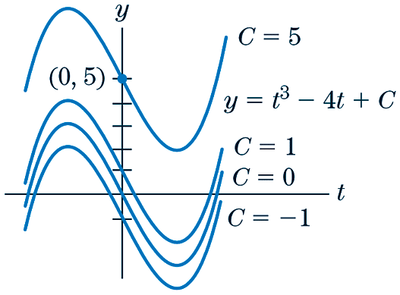
Solution Curves
Definition | Example
Solution Curves: The various graphs that correspond to solutions to a given differential equation

Slide 9
Constant Solutions of Differential Equations
EXAMPLE
Find a constant solution of
SOLUTION
Let f (t) = c for all t. Then f ΄(t) is zero for all t. If f (t) satisfies the differential equation
then
and so c = 5. This is the only possible value for a constant solution. Substitution shows that the function f (t) = 5 is indeed a solution of the differential equation.

Slide 10
Applications of Differential Equations
EXAMPLE
Let y = v(t) be the downward speed (in feet per second) of a skydiver after t seconds of free fall. This function satisfies the differential equation
What is the skydiver’s acceleration when her downward speed is 60 feet per second? (Note: Acceleration is the derivative of speed.)
SOLUTION
Since y = v(t), this means that y΄ = a(t) (acceleration). So the given differential equation represents the acceleration of the skydiver. Therefore, we will replace y in that equation with the speed 60 ft/s.

Slide 11
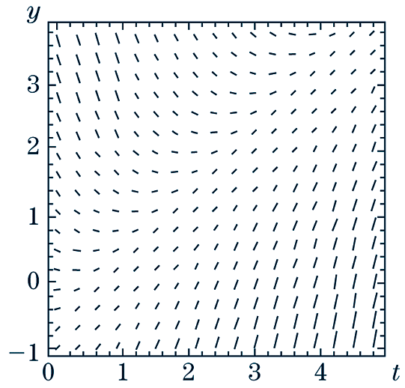
Slope Fields
Definition | Example
Slope Field: A geometric description of the set of integral curves that can be obtained by choosing a rectangular grid of points in the ty-plane, calculating the slopes of the tangent lines to the integral curves at the gridpoints, and drawing small segments of the tangent lines at those points | Slope field of

Slide 12
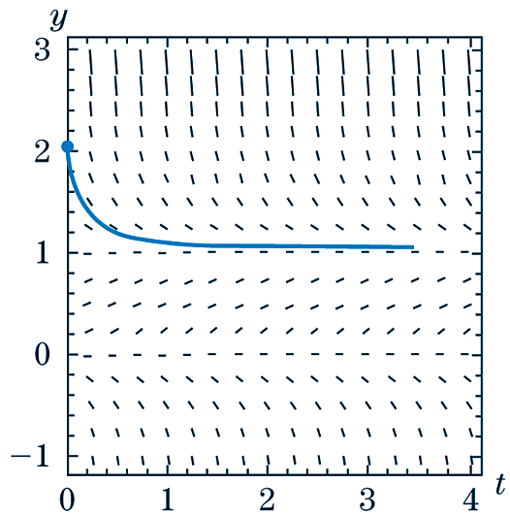
Applications of Using Slope Fields (1 of 3)
EXAMPLE
The figure below shows a slope field of the differential equation . With the help of this figure, determine the constant solutions, if any, of the differential equation. Verify your answer by substituting back into the equation.

Slide 13
Applications of Using Slope Fields (2 of 3)
CONTINUED
SOLUTION
Constant solutions are solutions of the form y = c, where c is a constant. Notice that the vertical axis for the graph of the slope field is labeled y. Therefore, we are looking for a part of the graph where y is constant, or is horizontal. It appears that the slope field is horizontal when y = 0 or y = 1.
y = 1
y = 0

Slide 14
Applications of Using Slope Fields (3 of 3)
CONTINUED
We now test our proposed solutions of y = 0 and y = 1 by plugging them into the original differential equation. Notice that in either case, y΄ = 0.
y = 0:
y = 1:
true
true
Therefore, the solutions are y = 0 and y = 1.

Slide 15
§ 10.2
Separation of Variables

Slide 16
Section Outline
Variables Are Separated
Initial Conditions
Variables Are Not Separated
Initial Value Problems

Slide 17
Variables Are Separated
EXAMPLE
Find all solutions of the differential equation
SOLUTION
(a) Write
(b) Integrate both sides wrt t:
(c) Rewrite left side canceling dt:
(d) Calculate the antiderivatives:
(e) Solve for y in terms of t:

Slide 18
Initial Conditions
EXAMPLE
Solve
SOLUTION
Satisfy the initial condition.

Slide 19
Variables Are Not Separated
EXAMPLE
Solve
SOLUTION
Note that dividing by y², we lost the solution y = 0, therefore, the solutions are

Slide 20
Initial Value Problem
EXAMPLE
Solve the initial-value problem
SOLUTION
Note that y = 0 is a solution.
Suppose y ≠ 0 and divide by y⁴.
Satisfy the initial condition.

Slide 21
§ 10.3
First-Order Linear Differential Equations

Slide 22
Section Outline
General Solution
Steps for Solving a First-Order Linear Differential Equation
Solving a First-Order Linear Differential Equation
Initial-Value Problem

Slide 23
First-Order Linear Differential Equation
The equation
where a(t) and b(t) are continuous functions on a given interval is called a first-order linear differential equation in standard form.

Slide 24
General Solution of a First-Order Linear Differential Equation
This equation gives all the solutions of a first-order linear differential equation.

Slide 25
Solving a First-Order Linear Differential Equation (1 of 2)
Step 1 Put the equation in the standard form .
Step 2 Compute an antiderivative of a(t),
[When evaluating
it is customary to choose 0
for the constant of integration.]
Form the integration factor .

Slide 26
Solving a First-Order Linear Differential Equation (2 of 2)
Step 3 Multiply the differential equation by
the integrating factor .
This transforms the terms of the left side of the equation into the
derivative of a product, ,
as in equation (3).
Step 4 Integrate to get rid of the derivative, and then solve for y.

Slide 27
A First-Order Differential Equation (1 of 3)
EXAMPLE
Solve
SOLUTION
(1) Multiply by 3t²:
Hence,
(2) An antiderivative of a(t) is:
Integrating factor is
(3) Multiply both sides by :

Slide 28
A First-Order Differential Equation (2 of 3)
SOLUTION
(4) Integrate both sides:
The solution curves for various values of C are:

Slide 29
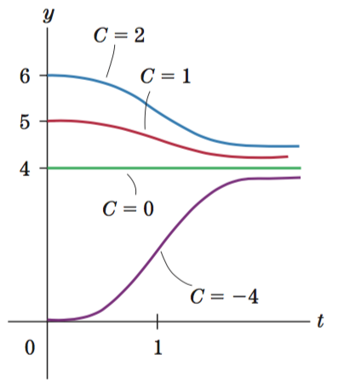
A First-Order Differential Equation (3 of 3)
SOLUTION
The solution curves for various values of C are:
Note the constant solution y = 4, which corresponds to C = 0.

Slide 30
Initial-Value Problem (1 of 3)
EXAMPLE
Solve the initial-value problem
SOLUTION
(1) Divide by t²:
(2) An antiderivative of is:
Integrating factor is
(3) Multiply both sides by t:

Slide 31
Initial-Value Problem (2 of 3)
SOLUTION
(4) Integrate both sides:
Satisfy the initial-value problem.

Slide 32
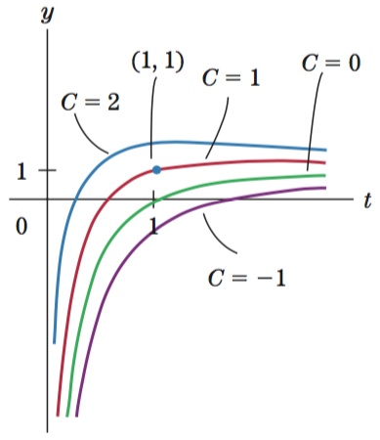
Initial-Value Problem (3 of 3)
SOLUTION
The solution curves for various values of C are:
The solution of the initial-value problem is the curve that goes through the point to (1, 1).

Slide 33
§ 10.4
Applications of First-Order Linear Differential Equations

Slide 34
Section Outline
Retirement Account
Population Model with Emigration
Newton’s Law of Cooling

Slide 35
Retirement Account (1 of 6)
EXAMPLE
You invest in a retirement account that pays 6% interest per year. You make an initial deposit of $1000 and plan on making future deposits at the rate of $2400 per year. Assume that the deposits are made continuously and that interest is compounded continuously. Let P(t) denote the amount of money in the account t years after the initial deposit.
Set up an initial-value problem that is satisfied by P(t).
Find P(t).

Slide 36
Retirement Account (2 of 6)
SOLUTION
(a) If only interest is added with constant proportionality: 6%
rate of change of y
constant of proportionality
amount in the account
Consider $2400 is deposited each year
rate of change of y
rate at which interest is added
rate at which money is deposited

Slide 37
Retirement Account (3 of 6)
SOLUTION
Since the initial deposit in the account was $1000, it follows that P(t) satisfies the initial condition y(0) = 1000. Putting the equation in standard form, we conclude that P(t) satisfies the initial-value problem

Slide 38
Retirement Account (4 of 6)
SOLUTION
(b) To solve the equation, use the step-by-step method:
integrating factor:
left side is a derivative of a product
Integrate both sides and for solve for y.

Slide 39
Retirement Account (5 of 6)
SOLUTION
Solve for y.
Simplify.
Satisfy initial conditions:

Slide 40
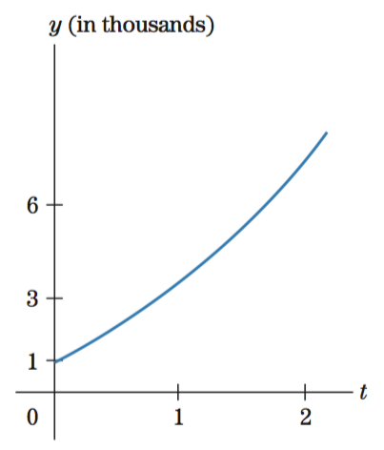
Retirement Account (6 of 6)
SOLUTION

Slide 41
A Population Model with Emigration (1 of 2)
EXAMPLE
In 2005, people in a country suffering from economic problems started to emigrate to other countries. Let P(t) denote the population of the country in millions t years after 2005. Sociologists studying this population deter- mined that for the next 30 years the number of people emigrating would gradually increase as the news of better prospects outside the country spread. Suppose that the rate of emigration is given by .004e^{0.04t} + .04 millions per year t years after 2005. Suppose
further that the growth constant of the population is . Find a differential equation satisfied by P(t).

Slide 42
A Population Model with Emigration (2 of 2)
SOLUTION
Rate of growth affected by two influences: rate at which population is growing and rate at which population is emigrating.
rate of change of y
rate at which population is growing
rate at which population is emigrating
The equation in standard form is:

Slide 43
Newton’s Law of Cooling (1 of 2)
EXAMPLE
A hungry college student, in a rush to eat, turns the oven on and puts a frozen pizza in it without preheating the oven. Let f(t) denote the temperature of the pizza and T(t) the oven’s temperature t minutes after the oven was turned on. According to Newton’s law of cooling, the rate of change of f(t) is proportional to the difference between the oven’s temperature and the temperature of the pizza. Find a differential equation that is satisfied by f(t).
SOLUTION
Rate of change of temperature of pizza is derivative of f(t).
This derivative is proportional to the difference T(t) – f(t). Thus, there exists a constant k such that

Slide 44
Newton’s Law of Cooling (2 of 2)
SOLUTION
While pizza is heating, temperature is rising, so is positive.
Temperature of oven always higher than temperature of pizza, so T(t) – f(t) is positive.
The differential equation satisfied by f(t) is:
where k is a positive constant.

Slide 45
§ 10.5
Graphing Solutions of Differential Equations

Slide 46
Section Outline
Properties of Differential Equations
Autonomous Differential Equation
Rules for Sketching a Solution to with Given
Constant Solutions and Graphing
Concavity of a Solution Curve

Slide 47
Autonomous Differential Equation
A differential equation of the form
is called autonomous.
The term autonomous here means “independent of time” and refers to the fact the the right side of depends only on y and not t.

Slide 48
Properties of Solutions (1 of 2)
Property I Corresponding to each zero of g(y), there is a constant solution of the differential equation. Specifically, if g(c) = 0, the constant function y = c is a solution.
Property II The constant solutions divide the ty-plane into horizontal strips. Each nonconstant solution lies completely in one strip.
Property III Each nonconstant solution is either strictly increasing or decreasing.
Property IV Each nonconstant solution either is asymptotic to a constant solution or else increases or decreases without bound.

Slide 49
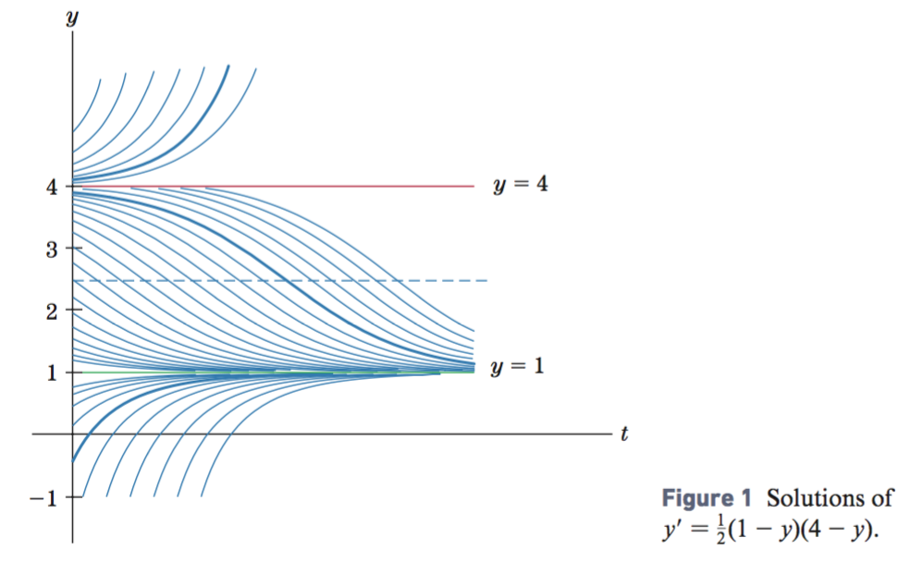
Properties of Solutions (2 of 2)
The following solution curves illustrate the properties.

Slide 50
An Autonomous Differential Equation (1 of 4)
EXAMPLE
Sketch the solution to that satisfies .
SOLUTION
Here
On the yz-coordinate system draw the graph of the function

Slide 51
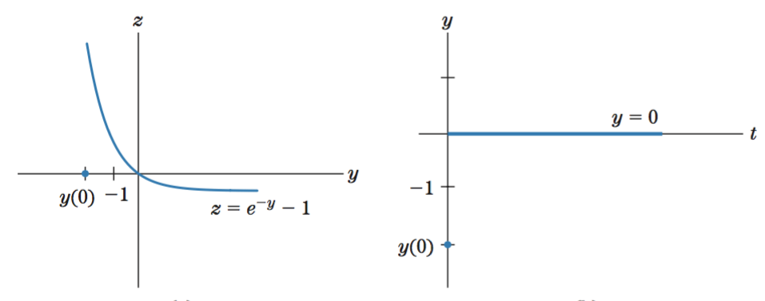
An Autonomous Differential Equation (2 of 4)
SOLUTION
has a zero when y = 0
has the constant solution y = 0

Slide 52
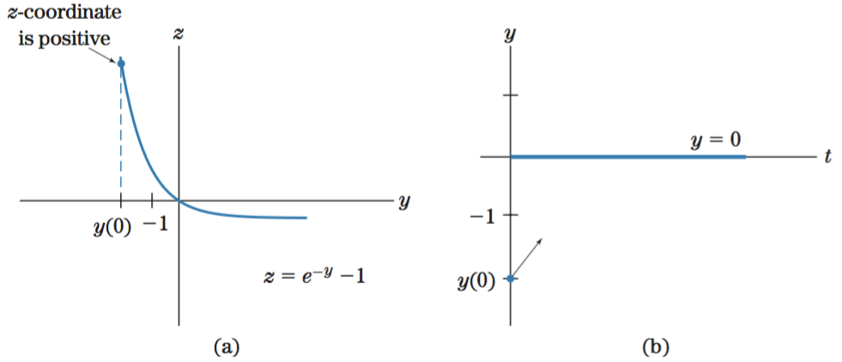
An Autonomous Differential Equation (3 of 4)
SOLUTION
Note that is positive when y = –2
, the derivative of the solution is positive, implies the
solution is increasing, place an arrow at the initial point

Slide 53
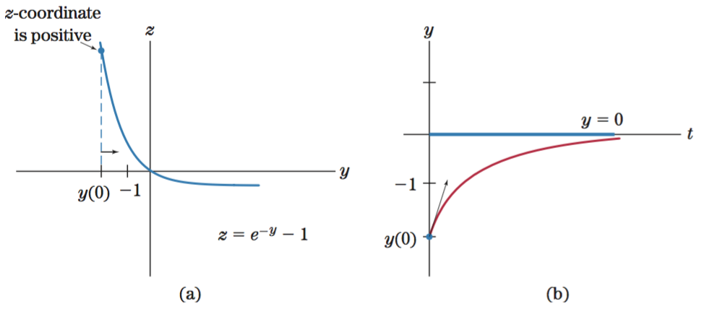
An Autonomous Differential Equation (4 of 4)
SOLUTION
Place an arrow to show that y will move from y = –2 toward y = 0
, the slope of the solution curve becomes less positive,
the solution curve is concave down

Slide 54
General Solution of a First-Order Linear Differential Equation
This equation gives all the solutions of a first-order linear differential equation.

Slide 55
Rules for Sketching Solution Curves (1 of 2)
1. Sketch the graph of z = g(y) on a yz-coordinate system. Find and label the zeros of g(y).
2. For each zero c of g(y), draw the constant solution y = c on the ty-coordinate system.
3. Plot y(0) on the y-axis of the two coordinate systems.
4. Determine whether the value of g(y) is positive or negative when y = y(0). This tells us whether the solution is increasing or decreasing. On the ty-graph, indicate the direction of the solution through y(0).
5. On the yz-graph, indicate in which direction y should move. (Note: If y is moving down on the ty-graph, y moves to the left on the yz-graph.) As y moves in the proper direction on the yz-graph, determine whether g(y) becomes more positive, less positive, more negative, or less negative. This tells us the concavity of the solution.

Slide 56
Rules for Sketching Solution Curves (2 of 2)
6. Beginning at y(0) on the ty-graph, sketch the solution, being guided by the principle that the solution will grow (positively or negatively) without bound unless it encounters a constant solution. In this case, it will approach the constant solution asymptotically.
7. On the ty-coordinate system, draw dashed horizontal lines at all values of y at which g(y) has a nonzero relative maximum or minimum point. A solution curve will have an inflection point whenever it crosses such a dashed line.

Slide 57
Constant Solution & Graphing (1 of 3)
EXAMPLE
Sketch solutions to
satisfying y(0) = 4.5 and y(0) = 3.
SOLUTION
Since g(y) = y² – 4y = y(y – 4), the zeros are y = 0 and y = 4.
The solution satisfying y(0) = 4.5 is increasing, because the z coordinate is positive when y = 4.5 on the yz-graph and it continues to increase without bound.
The solution satisfying y(0) = 3 is decreasing, because the z coordinate is negative when y = 3 on the yz-graph and it approaches y = 0 asymptotically.

Slide 58
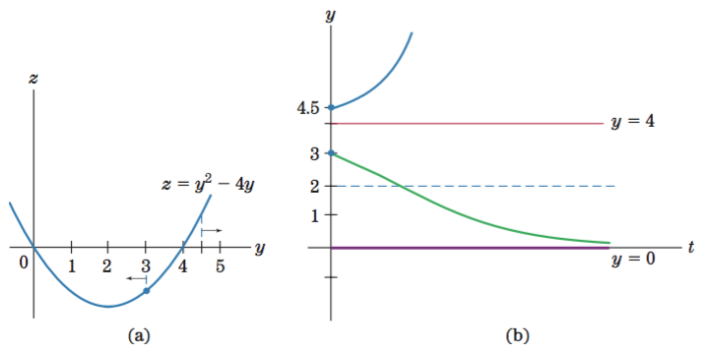
Constant Solution & Graphing (2 of 3)
SOLUTION

Slide 59
Constant Solution & Graphing (3 of 3)
SOLUTION
In (a) the z-coordinates become more negative until y reaches 2 and then become less negative as y moves on toward 0.
Since these z-coordinates are slopes on the solution curve, we conclude that, as the solution moves downward from its initial point on the ty-coordinate system, its slope becomes more negative until the y-coordinate is 2, and then, the slope becomes less negative as the y-coordinate approaches 0. Hence, the solution is concave down until y = 2 and then is concave up. Thus, there is an inflection point at y = 2, where the concavity changes.

Slide 60
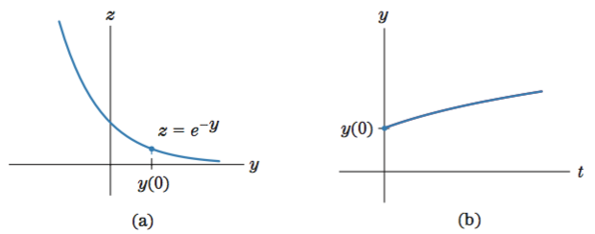
Concavity of a Solution (1 of 2)
EXAMPLE
Sketch a solution to
with y(0) > 0.
SOLUTION
Since is always positive, there are no constant solutions to the differential equation, and every solution will increase without bound.

Slide 61
Concavity of a Solution (2 of 2)
SOLUTION
When drawing solutions that asymptotically approach a horizontal line, we have no choice as to whether to draw it concave up or concave down.
This decision will be obvious from its increasing or decreasing nature and from knowledge of inflection points. However, for solutions that grow without bound, we must look at g(y) to determine concavity. In this example, as t increases, the values of y increase. As y increases, g(y) becomes less positive. Since g(y) = y′, we deduce that the slope of the solution curve becomes less positive, therefore, the solution curve is concave down.

Slide 62
§ 10.6
Applications of Differential Equations

Slide 63
Section Outline
Setting up a Differential Equation
Logistic Growth Differential Equation
Fish Population
Savings Account with Withdrawals

Slide 64
Setting up a Differential Equation
EXAMPLE
The by-product coke oven was first introduced into the iron and steel industry in 1894. It took about 30 years before all the major steel producers had adopted this innovation. Let f(t) be the percentage of the producers that had installed the new coke ovens by time t. Then, a reasonable model for the way f(t) increased is given by the assumption that the rate of change of f(t) at time t was proportional to the product of f(t) and the percentage of firms that had not yet installed the new coke ovens at time t. Write a differential equation that is satisfied by f(t).
SOLUTION
100 – f(t) is the percentage of firms that have not installed ovens. Rate of change is proportional to the product.
k is positive.

Slide 65
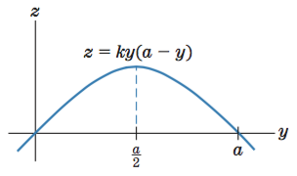
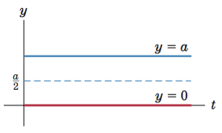
Logistic Growth (1 of 3)
Logistic differential equation
yz-graph for a logistic differential equation: quadratic
tz-graph for a logistic differential equation: quadratic
dashed line is where certain solution curves will have an inflection point

Slide 66
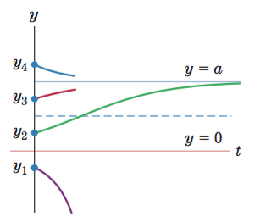
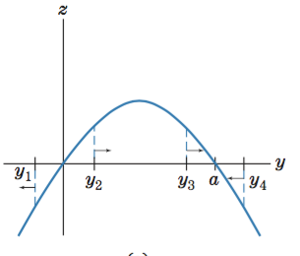
Logistic Growth (2 of 3)
general shape of a yz-graph for a solution to a quadratic logistic differential equation
possible solution curves on a tz-graph for a quadratic logistic differential equation

Slide 67
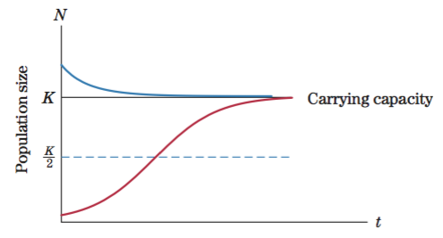
Logistic Growth (3 of 3)
Ecology logistic growth

Slide 68
Fish Population (1 of 3)
EXAMPLE
A pond on a fish farm has a carrying capacity of 1000 fish. The pond was originally stocked with 100 fish. Let N(t) denote the number of fish in the pond after t months.
(a) Set up a logistic differential equation satisfied by N(t), and plot an approximate graph of the fish population.
(b) Find the size of the population of fish with the highest rate of growth. Find this rate, given that the intrinsic rate of growth is .3.
SOLUTION
It’s a logistic equation with carrying capacity K = 1000.
k is positive.

Slide 69
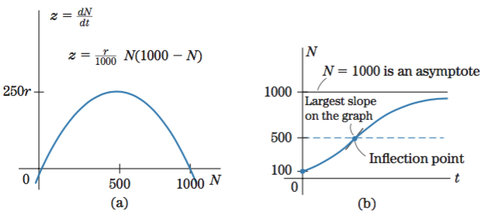
Fish Population (2 of 3)
SOLUTION
The fish population at time t is given by the solution of this differential equation with the initial condition N(0) = 100.

Slide 70
Fish Population (3 of 3)
SOLUTION
The size of the population with the highest rate of growth is 500. To find the numerical value of the fastest growth rate, given that r = .3, we substitute r = .3 and N = 500 into the equation and get
= 475 fish per month.
This is the maximum rate of growth of the fish population. It is attained when 500 fish are in the pond. Note that 500 is not the maximum size of the population. In fact, we know that the fish population will approach 1000 asymptotically.

Slide 71
Savings Account with Withdrawals (1 of 2)
EXAMPLE
A savings account earns 6% interest per year, compounded continuously, and continuous withdrawals are made from the account at the rate of $900 per year. Set up a differential equation that is satisfied by the amount f(t) of money in the account at time t. Sketch typical solutions of the differential equation.
SOLUTION
Ignoring withdrawals, the savings account grows at a rate proportional to the size of the account. Since this growth comes from the interest, we conclude that interest is being added to the account at a rate proportional to the amount in the account.

Slide 72
Savings Account with Withdrawals (2 of 2)
SOLUTION
Now, consider the withdrawals. The amount in the account is affected by two influences: rate at which interest is added and rate at which money is withdrawn.
rate of change of y
rate at which interest is added
rate at which money is withdrawn
That is

Slide 73
Savings Account with Withdrawals (2 of 2)
SOLUTION
Find the constant solution by solving , which gives y = 15,000. If the initial amount y(0) in the account is $15,000, the balance in the account will always be $15,000. If the initial amount is greater than $15,000, the account will accumulate without bound. If the initial amount is less than $15,000, the account will decrease.

Slide 74
§ 10.7
Numerical Solution of Differential Equations

Slide 75
Section Outline
Euler’s Method

Slide 76
Approximate Solutions
Many differential equations that arise in real-life applications cannot be solved by any known method. However, approximate solutions may be obtained by several different numerical techniques. In this section we describe what is known as Euler’s method for approximating solutions to initial-value problems of the form
for values of t in some interval a ≤ t ≤ b Here, g(t, y) is some reasonably well-behaved function of two variables.

Slide 77
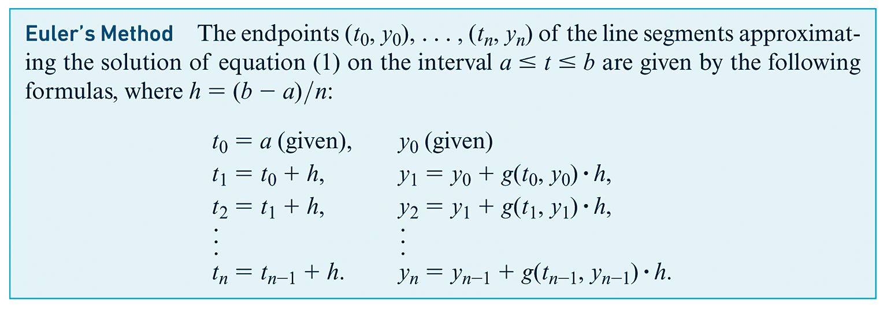
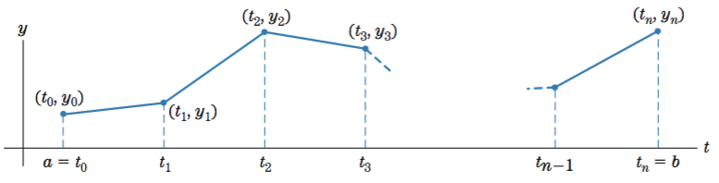
Euler’s Method

Slide 78
Euler’s Method (1 of 3)
EXAMPLE
Use Euler’s Method with
to approximate the solution
to
, for t in the interval
. In particular,
estimate
.
SOLUTION
and
Here
Starting with
, we find that
Thus,
Next,
Next,
Finally,

Slide 79
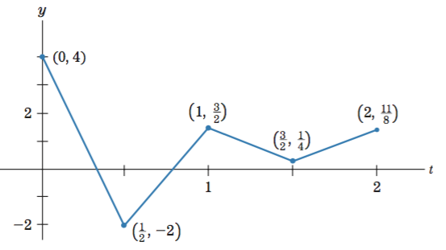
Euler’s Method (2 of 3)
SOLUTION
Thus, the approximation to the solution is given by the following polygonal path
The last point
is close to the graph of
at
so

Slide 80
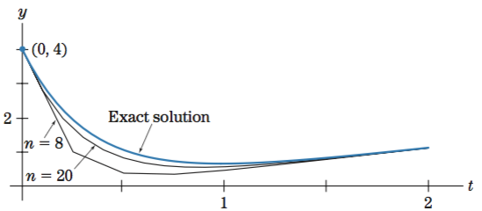
Euler’s Method (3 of 3)
SOLUTION
Actually, this polygonal path is somewhat misleading. We can improve the accuracy dramatically by increasing the value of n. The figure shows the Euler approximations for n = 8 and n = 20. The graph of the exact solution is shown for comparison.

